Slide 1
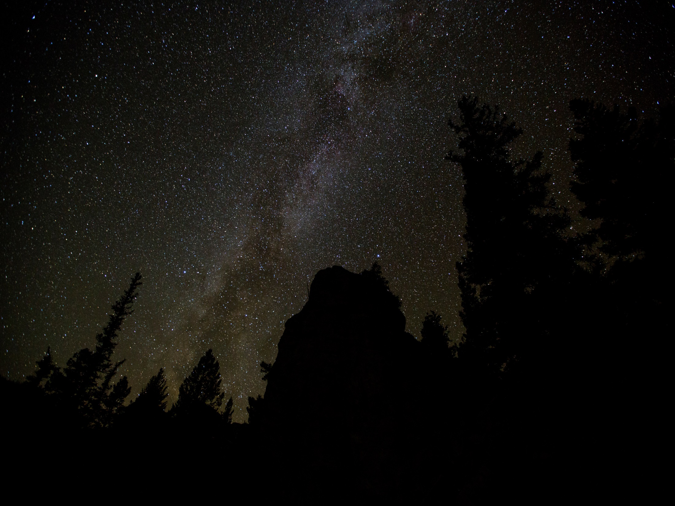
Workout Summary
Time
1:21:30
Distance
1:21:30
Calories
1:21:30
Save

